Slide 1

ERAU ASCEND!
Data Acquistion
Presented By: Geimi DeLarge

Slide 2
Overview
Data Logging Components
  Picaxe
  SD Logger
  Temperature & Pressure Sensors
Atmospheric Data - Results
  Temperature
  Pressure
Conclusions

Slide 3
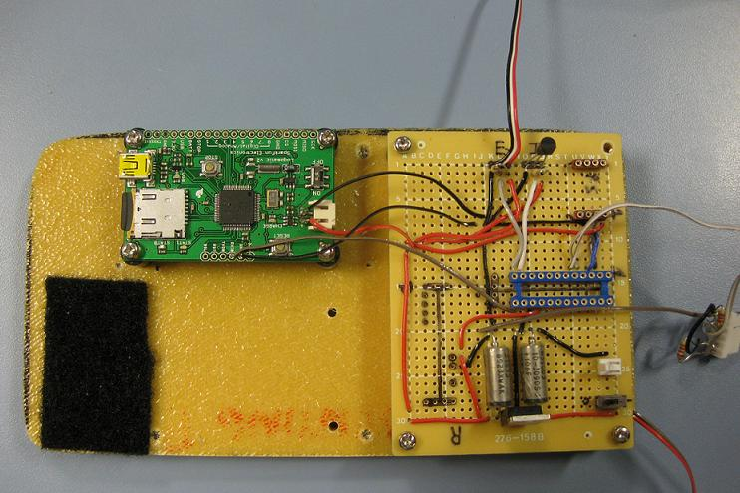
The System
Internal Temperature
SD Logger
Pressure Sensor
Picaxe 28X1
Voltage Regulator

Slide 4
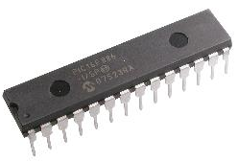
Picaxe Microcontroller
UK-based microcontroller system
Basic Programming Language
28-X1 Chip
Faster Serial Output Capabilities
Larger Memory
Converts Analog Signal
  8 bit
  10 bit
Source: www.hvwtech.com

Slide 5
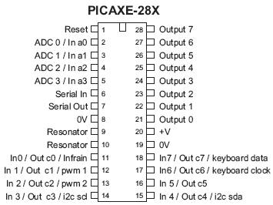
Picaxe Microcontroller
Source: www.hvwtech.com

Slide 6
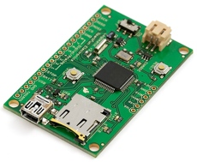
Logomatic Data Logger
Utilizes MicroSD Card – Up to 2GB
FAT16 Format
USB Connections
Serial Input From Picaxe
Source: www.inmotion.pt

Slide 7
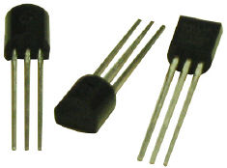
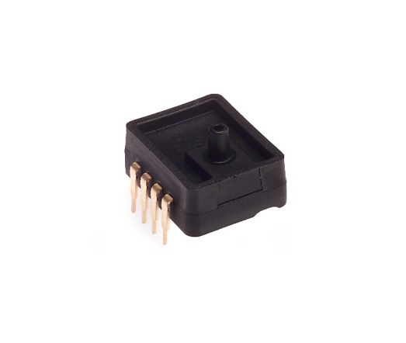
Temperature & Pressure Sensors
Dallas DS18B20 – One Wire Device
Digital Sensor
Internal/External
9 – 12 bit Measurements
Degrees Celsius
Range of -55°C to +125°C
Accurate to ±0.5°C
Honywell Analog Pressure Sensor – ASDX Series
Analog Sensor
Approx. Frequency : 1Hz
Range: 0 – 15 psi
Absolute Pressure
Source: www.embeddeddatasystems.com
Source: http://rocky.digikey.com

Slide 8
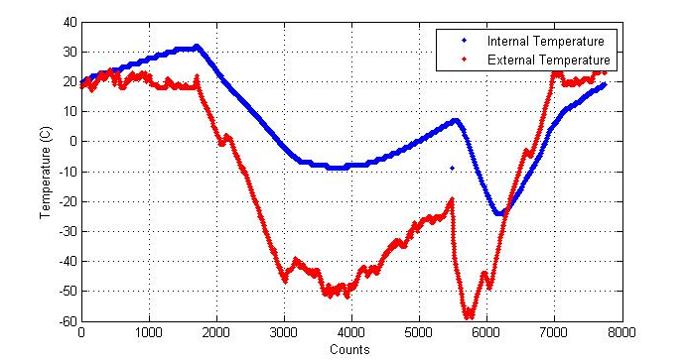
Temperature Data

Slide 9
Pressure Data

Slide 10
Pressure Data

Slide 11
Conclusions
Sucessful Data Acquistion
    Temperature & Pressure
Successful system integration of all components
Gained valuable knowledge about digital/analog systems

Slide 12
Questions?

